Slide 1

Predicting Nurse Attrition in US Healthcare: A Data-Driven Approach
BY: Andrew Chen
Notes:
Today, I'm excited to delve into a topic that's not only pertinent to the healthcare industry but also crucial for the well-being of both healthcare professionals and patients alike: nurse attrition.

Slide 2

Introduction
Nurse attrition is a pressing issue impacting workforce stability and patient care in hospitals.
The project aims to develop predictive models using supervised machine learning techniques to analyze factors contributing to nurse attrition.
By accurately predicting whether an employee will leave or remain with an organization, we can help healthcare institutions implement targeted retention strategies to mitigate attrition rates.
Notes:
Nurse attrition, the departure of nursing staff from healthcare institutions, poses significant challenges. It disrupts the stability of healthcare workforces, leading to increased workloads, burnout, and decreased morale among remaining staff. Moreover, it directly impacts patient care quality, as continuity of care and patient-provider relationships may suffer in the absence of experienced nursing staff.
Recognizing these challenges, our project is dedicated to developing predictive models using machine learning techniques to understand the underlying factors contributing to nurse attrition. By gaining insights into why nurses leave their positions, we aim to empower healthcare institutions to implement targeted retention strategies. These strategies, informed by accurate predictions of employee turnover, can help mitigate attrition rates, thereby fostering a more stable and supportive work environment for nursing staff and improving patient outcomes.
Our journey today will take us through the methodologies, data, model performances, and optimization strategies employed in our pursuit of addressing nurse attrition. Without further ado, let's dive in."

Slide 3
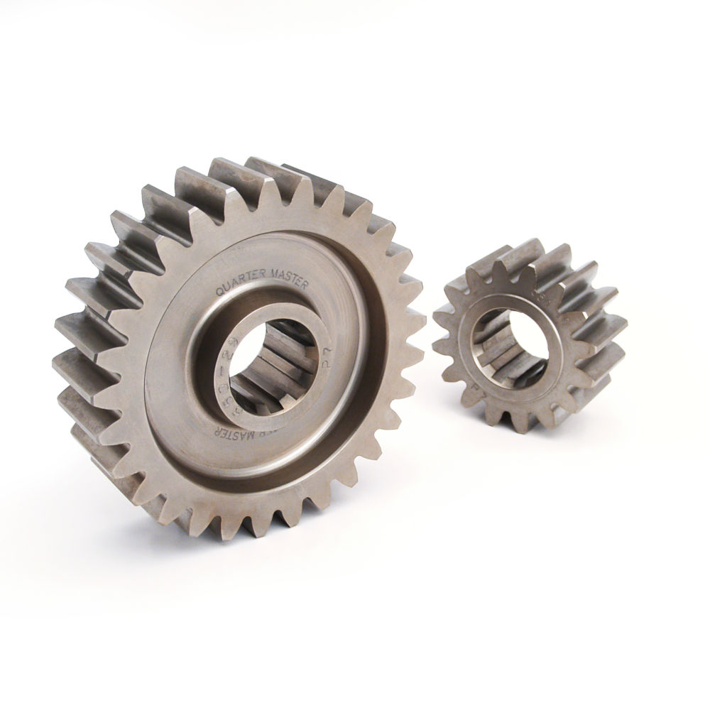
Machine Learning Approach
Utilize logistic regression, K-nearest neighbors (KNN), and Random Forest algorithms.
Data: Dataset synthesized for this project, focusing on employee and company-related information.
Evaluation Metrics: Precision, recall, F1-score, and accuracy.
Notes:
"Let's explore the machine learning methodologies I am employing in my project. I've carefully selected three powerful algorithms known for their ability to handle classification tasks: logistic regression, K-nearest neighbors (KNN), and Random Forest.
Logistic regression is a widely-used linear model that's particularly effective for binary classification problems, making it an ideal choice for predicting whether a nurse will stay or leave their position.
K-nearest neighbors, on the other hand, is a non-parametric algorithm that classifies data points based on the majority class of their nearest neighbors. This proximity-based approach can capture complex relationships within the data but may struggle with high-dimensional datasets or class imbalances.
Finally, Random Forest is an ensemble learning method that combines multiple decision trees to improve predictive accuracy and robustness. Its ability to handle nonlinear relationships and feature interactions makes it well-suited for our task of predicting nurse attrition.
To support our analysis, we've synthesized a dataset containing a rich set of employee and company-related variables. Throughout our evaluation, we'll assess model performance using precision, recall, F1-score, and accuracy metrics to ensure the reliability and effectiveness of our predictive models."

Slide 4
Data
The DataFrame comprises 1676 rows and 35 columns, denoting instances and features, respectively.
There are no null values present in the dataset, eliminating the need for dropping any observations.
The target features exhibit an imbalance, requiring attention to ensure balanced representation.
To address the imbalance, a random sampling method will be employed to resample attrition, aiming for a count of 1000 instances for each target attribution.
Notes:
Now, let's take a closer look at the data fueling our analysis. Our dataset comprises 1676 rows and 35 columns, representing individual instances and features, respectively. These features encompass a wide range of employee demographics, job-related characteristics, and organizational factors.
One notable aspect of our dataset is the absence of null values, which eliminates the need for imputation or data cleansing procedures. However, upon closer inspection, we've identified an imbalance in our target feature, indicating that a significantly higher proportion of nurses are labeled as 'staying' rather than 'leaving' their positions.
To address this imbalance and ensure equitable representation of both classes, we plan to employ a random sampling method. By randomly selecting a subset of instances from the majority class ('staying') to match the count of instances in the minority class ('leaving'), we aim to achieve a balanced dataset for training and evaluation purposes."

Slide 5
Multicollinearity
Low Multicollinearity: close to 1, minimal correlation between predictor variables
Moderate Multicollinearity: between 1 and 5, a moderate level of correlation between predictor variables
High Multicollinearity: greater than 5, signifies a significant degree of correlation between predictor variables
Notes:
"Before delving into model performances, it's essential to consider the potential impact of multicollinearity on our analysis. Multicollinearity refers to the presence of high correlations between predictor variables, which can lead to inflated standard errors and inaccurate coefficient estimates in regression models.
To assess multicollinearity within our dataset, we've calculated the Variance Inflation Factor (VIF) for each feature. The VIF measures the extent to which the variance of an estimated regression coefficient is increased due to multicollinearity.
Our analysis reveals varying levels of multicollinearity across features, with some exhibiting low VIF values indicating minimal correlation, while others demonstrate moderate to high VIF values suggesting more pronounced correlations. Understanding these relationships is crucial for interpreting model results accurately and identifying potential confounding variables."

Slide 6
Logistic Model
Logistic Regression: Achieved 93% accuracy, balancing precision and recall for both classes.
High precision (0.98) for class 0 indicates a low false positive rate
The F1-score for class 1 (0.73)
Notes:
"Now, let's evaluate the performance of our predictive models. We'll start by examining the results of logistic regression, which demonstrates balanced performance across precision, recall, and F1-score metrics. Specifically:
Precision: 0.65 for predicting nurse attrition (class 1), indicating that when the model predicts attrition, it is correct 65% of the time.
Recall: 0.83 for predicting nurse attrition (class 1), suggesting that the model identifies 83% of actual attrition cases.
F1-score: 0.73, which is the harmonic mean of precision and recall, providing a single measure of the model's performance.
This indicates that the logistic regression model effectively captures both true positives and true negatives, providing reliable predictions of nurse attrition.

Slide 7
KNN Model
KNN: Achieved 88% accuracy, balancing precision and recall for both classes.
High precision (0.91) for class 0
Recall for class 1 is relatively low (0.31)
F1-score for class 1 is also low (0.39).
Notes:
Moving on to K-nearest neighbors, we observe a different picture. While the model achieves respectable precision for predicting nurses who stay in their positions, it struggles with recall, particularly for identifying nurses who are likely to leave. Specifically:
Precision: 0.51 for predicting nurse attrition (class 1), indicating that when the model predicts attrition, it is correct 51% of the time.
Recall: 0.31 for predicting nurse attrition (class 1), suggesting that the model identifies only 31% of actual attrition cases.
F1-score: 0.39, reflecting the model's overall performance in terms of both precision and recall.
This discrepancy suggests that the model may be overly conservative in its predictions, potentially missing important attrition cases.

Slide 8
Random Forest Model
Random Forest: Achieved 92% accuracy, balancing precision and recall for both classes.
High precision (0.93) for class 0
Recall for Class 1 is relatively low (0.45)
F1-score for class 1 is also moderate (0.58)
Notes:
Finally, our Random Forest model shows promise in capturing the complexity of the data, resulting in high precision for nurses who stay. However, it exhibits lower recall for nurses who leave, indicating challenges in accurately identifying attrition cases. Specifically:
Precision: 0.84 for predicting nurse attrition (class 1), indicating a high percentage of correct predictions for attrition cases.
Recall: 0.45 for predicting nurse attrition (class 1), suggesting that the model identifies only 45% of actual attrition cases.
F1-score: 0.58, reflecting the model's overall performance in terms of both precision and recall.
This discrepancy may stem from the class imbalance present in our dataset, highlighting the importance of addressing such issues in model development."

Slide 9
Optimization Strategies
GridSearchCV for tuning hyperparameters of a k-Nearest Neighbors (KNN) classifier. It defines a parameter grid (knn_params) consisting of the number of neighbors ('n_neighbors'), the weighting method ('weights'), and the distance metric ('p'). Employing 10-fold cross-validation
Hyperparameter optimization for a Random Forest classifier using a grid search approach, iterating over specified parameter combinations including 'max_depth', 'min_samples_split', 'min_samples_leaf', and 'max_features'. Employing 5-fold cross-validation.
Notes:
"To enhance the performance of our predictive models, we've implemented optimization strategies aimed at fine-tuning model hyperparameters. For K-nearest neighbors, we've utilized GridSearchCV, a technique for hyperparameter optimization that exhaustively searches through a specified parameter grid to identify the optimal combination of hyperparameters. By tuning parameters such as the number of neighbors and distance metrics, we aim to improve the model's ability to capture complex relationships within the data.
Similarly, for Random Forest, we've employed a grid search approach to explore various combinations of hyperparameters, including max depth, min samples split, min samples leaf, and max features. By iteratively tuning these parameters and evaluating model performance using cross-validation, we can identify the configuration that yields the best predictive accuracy and generalization performance."

Slide 10
Conclusion
Precision and recall metrics highlight strengths and weaknesses of each model.
Logistic regression showed balanced performance, while KNN and Random Forest struggled with class imbalance and accurate prediction of attrition cases.
Notes:
"As we wrap up our analysis, let's reflect on the precision and recall metrics, which provide valuable insights into our models' strengths and weaknesses. While logistic regression demonstrates balanced performance across both metrics, K-nearest neighbors and Random Forest struggle with accurately identifying attrition cases, particularly due to the class imbalance present in our dataset.
These findings underscore the importance of understanding the nuances of model performance and the challenges posed by real-world data. Moving forward, we'll continue to refine our models, address underlying issues such as class imbalance, and explore alternative techniques to improve predictive accuracy and robustness.
In conclusion, our project represents a significant step towards addressing the complex issue of nurse attrition using advanced machine learning techniques. By gaining insights into the factors influencing nurse turnover and developing accurate predictive models, we aim to empower healthcare institutions to implement targeted retention strategies, ultimately fostering a more stable and supportive work environment for nursing staff and enhancing patient care quality.

Slide 11
Data source
J. P. Miller. (n.d.). Employee Attrition for Healthcare. Kaggl https://www.kaggle.com/datasets/jpmiller/employee-attrition-for-healthcare/datare
Notes:
Here’s the data source, Thank you

